Slide 1
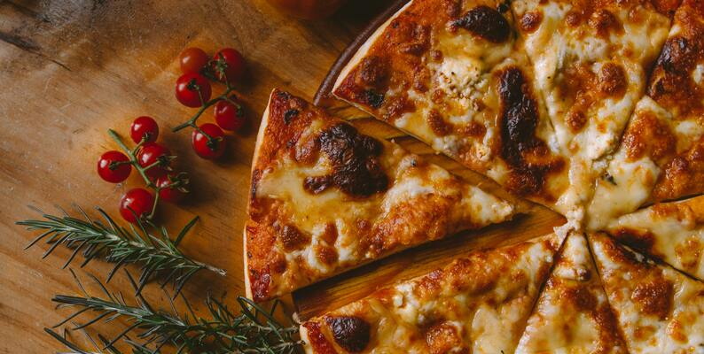
"Pizza Place Sales Analysis"
"Uncovering Trends and Opportunities"

Slide 2
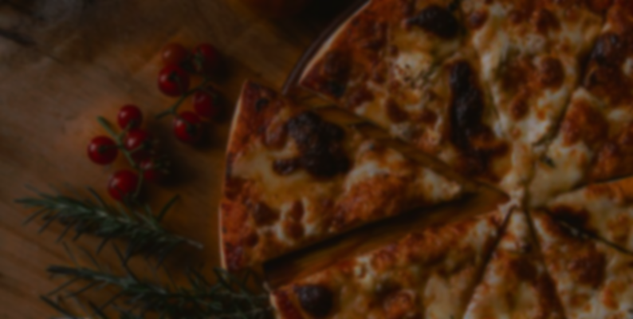
Introduction
The project aims to address issues related to the smooth flow of marketing domains, specifically Product, Price, Promotion, Place, and People. It is strategic in nature, aiming to enhance overall business effectiveness.
The need for this project arises from identified problems within these domains. Customer insights and data support the decision to undertake this initiative. The project is of substantial size, covering multiple marketing domains and involving data analysis.
The project involves a step-by-step process, starting with a thorough examination of the five marketing domains. It aims to understand and enhance the flow between these departments.
The scope also includes identifying areas for improvement to mitigate the impact of existing problems. Stakeholders will play a crucial role in this process.

Slide 3
Dataset Overview
The analysis of a year's worth of sales data from our fictitious pizza place provides valuable insights into customer behaviour, order patterns, and revenue generation.
This report aims to uncover key trends and opportunities for improvement in the business.
The dataset includes details such as the date and time of each order, pizza type, size, quantity, price, and ingredients.
The recommended analysis focuses on understanding daily customer counts, peak hours, average pizza quantity per order, bestselling pizzas, annual revenue, and identifying potential menu optimizations or promotional strategies.

Slide 4
Daily Customer Counts and Peak Hours
Daily Orders
Peak Hours

Slide 5
Average Pizza Quantity per Order and Bestsellers
DAILY ORDERS: AVERAGE 135
Orders per Person: 0-5 units
Bestseller pizza is “The Thai Chicken Pizza”
Large size pizza’s are the most preferrable pizza in top 10 and all the pizza’s

Slide 6
Annual Revenue and Seasonality

Slide 7
Menu Optimization and Promotions

Slide 8
Findings Summary
This dataset contain “Pizza Place Sales” data, which 1 year data (2015).
The dataset contain 48621 total entries of 21351 unique order id (customer id).
The total revenue of year is $801944.7 & Daily ORDERS:AVERAGE 135.
Customer rush hours are 12:00pm-18:00pm , average one person order 5 units of pizza.
39% orders are mostly large size pizza &48% total of revenue came from large size pizza.
In July($71000) month is most revenue booster month & March to August, these month having $67000+ revenue collected.
The Thai Chicken Pizza is best performer in terms of orders & sales.
Above Large size pizza category are under performing ,so we need to give a discount on above large size or delist this category.

Slide 9
Recommendations
1. Staffing and Operations:- Adjust staffing levels based on peak hours to enhance customer service. Streamline operations during slower periods to optimize resources.
2. Marketing and Promotions:- Develop targeted marketing campaigns during peak hours or on specific days. Highlight bestselling pizzas in promotional materials to attract more customers.
3. Menu Revitalization:- Consider removing or reimagining underperforming pizzas. Introduce new pizzas or variations based on customer preferences.
4. Seasonal Promotions:- Plan seasonal promotions to capitalize on identified peak periods. Offer discounts or special deals during slower seasons to boost sales.
5. Education & training of the staff members for customer handling and well communication.

Slide 10
Operational Improvements
Staffing Adjustments During Peak Hours:
Cross-Train Employees
Implement Flexible Scheduling
Utilize Part-Time or Temporary Staff
Implement Performance Incentives
Implement Technology Solutions
Monitor and Analyze Data
Implement Queue Management Systems
Operational Optimizations During Slower Periods:
Training and Development
Deep Cleaning and Maintenance
Menu/Product Development
Marketing and Promotions
Inventory Management
Employee Cross-Training
Energy Efficiency Measures
Customer Feedback and Surveys

Slide 11
Marketing Strategies
Targeted Marketing and Promotions Strategies
Customer Segmentation
Loyalty Programs
Personalized Offers
Social Media Advertising
Collaborations and Partnerships
Geo-Targeted Ads
Online Reviews and Testimonials
Email Marketing Campaigns
Utilizing Bestselling Pizzas in Promotional Materials
Bundle Deals
Limited-Time Offers
Customer Favorites Menu
Social Media Contests
Upselling and Cross-Selling
Customer Testimonials
Exclusive VIP Offers
Seasonal Variations

Slide 12
Menu Revitalization
Following point are helpful
Sales Analysis Customer Feedback
Profitability Assessment
Seasonal Considerations
Menu Simplification
Competitive Analysis
Limited-Time Feedback
Customer Surveys
Trend Analysis
Seasonal Specials
Marketing Campaigns
Upselling Strategies
Customer Favorites
Health-Conscious Options

Slide 13
Seasonal Promotions
Strategies for Planning Seasonal Promotions
Understand
Align with Holidays and Events
Limited-Time Menu Items
Weather-Responsive Promotions
Bundle Deals
Loyalty Programs
Social Media Campaigns
Collaborations
Early-Bird Specials
Themed Events
Offering Discounts During Slower Seasons
Off-Peak Hours Discounts
Weekday Specials
Subscription Services
Flash Sales
Bundle Deals for Regulars
Digital Marketing Campaigns
Collaborate with Local Businesses
Seasonal Discount Cards
Survey and Reward
Referral Discounts

Slide 14
Conclusion
The analysis of pizza place sales data provides actionable insights for improving operations, marketing strategies, and menu offerings. By leveraging these findings, the pizza place can enhance customer satisfaction, drive sales, and ultimately optimize business performance.
By combining staffing adjustments during peak hours with operational optimizations during slower periods, you can create a more agile and efficient business operation.
By combining targeted marketing strategies with the promotion of bestselling pizzas, you can create compelling campaigns that resonate with your audience and drive both new and repeat business.
Regularly evaluating and adjusting your pizza menu based on performance is essential for keeping your offerings fresh, appealing, and aligned with customer preferences. It's important to strike a balance between maintaining popular classics and introducing innovative options to keep customers excited about your menu.
By strategically planning seasonal promotions and offering discounts during slower seasons, you can effectively manage demand, attract new customers, and retain existing ones. It's crucial to stay flexible and adapt your promotions based on the unique characteristics of each season and the evolving preferences of your customer base.

Slide 15
Q&A

Slide 16
THANK YOU
PROJECT BY
KSHITIJ KHANDARE
Gmail-id:- Kshitij.khandare@gmail.com
Portfolio link:- https://peerlist.io/kshitij_k
Linkedin id:- https://www.linkedin.com/in/kshitij-khandare-7a7161111
Github id:- https://github.com/KshitijKhandare

